Slide 1
AntConc Demo
Haoshan (Sally) Ren, PhD Student Georgia State Dept. of Applied Linguistics and ESL

Slide 2
Using Antconc
Download practice files
Install AntConc
Load text files to AntConc
Search for patterns

Slide 3
Install AntConc
Go to : https://www.laurenceanthony.net/software/antconc/

Slide 4
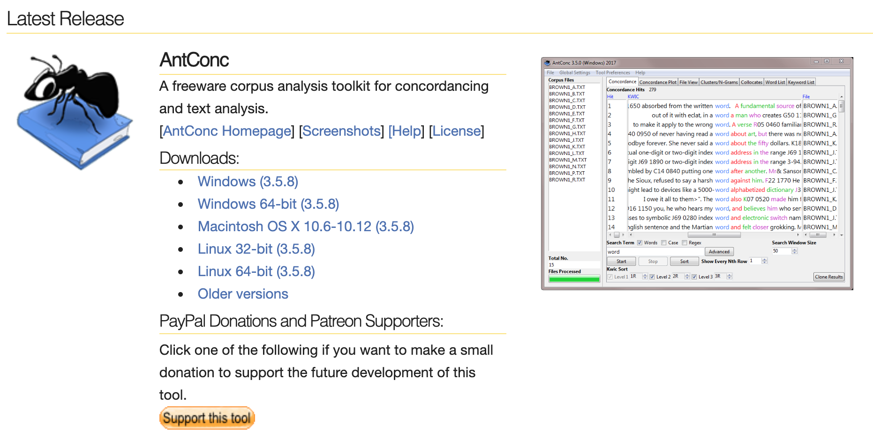
2) Choose your version

Slide 5
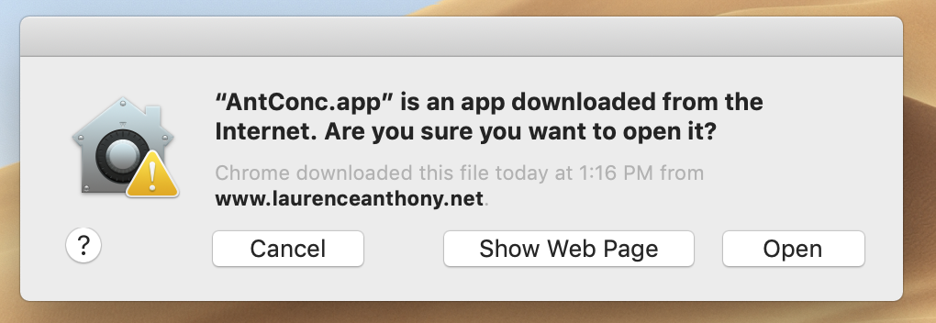
3) Allows it to open

Slide 6
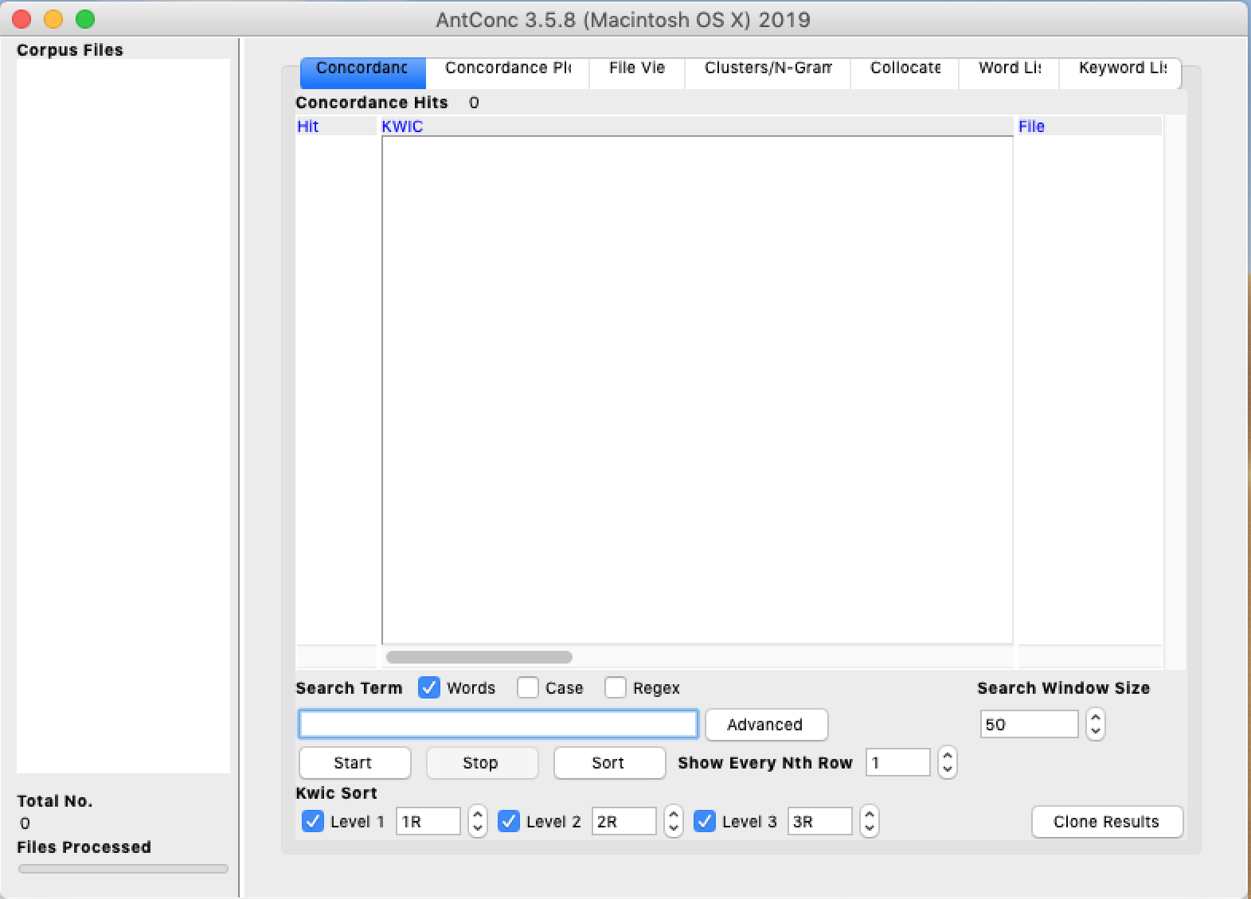
AntConc
Interface

Slide 7
Locate your tool bar

Slide 8
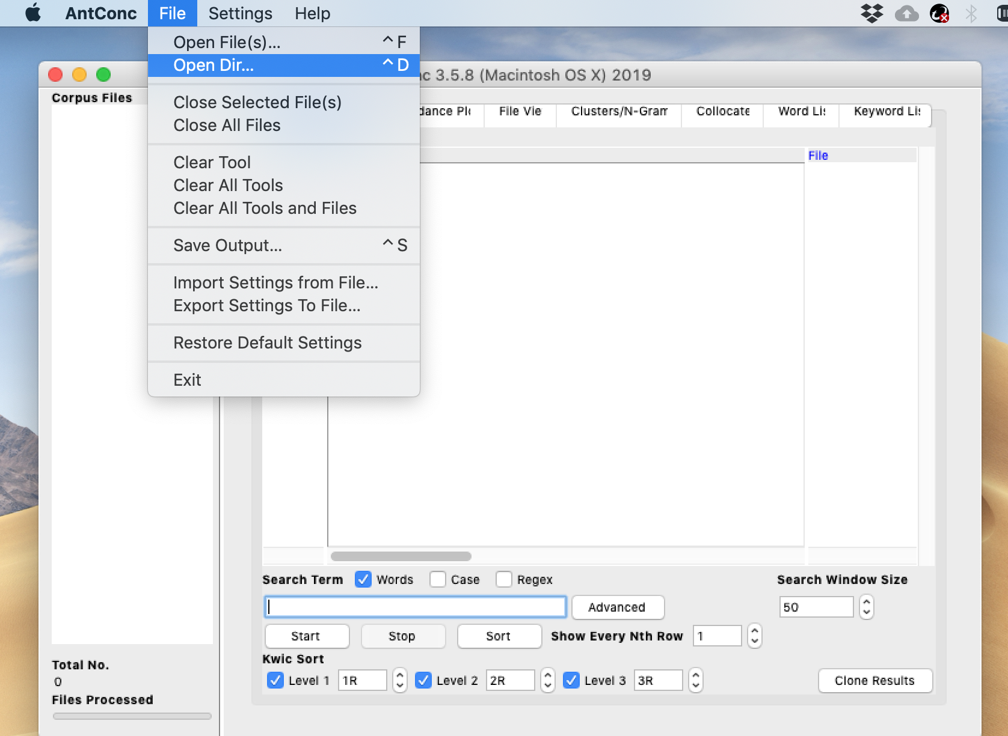
Individual files
Files in a folder
Loading files

Slide 9
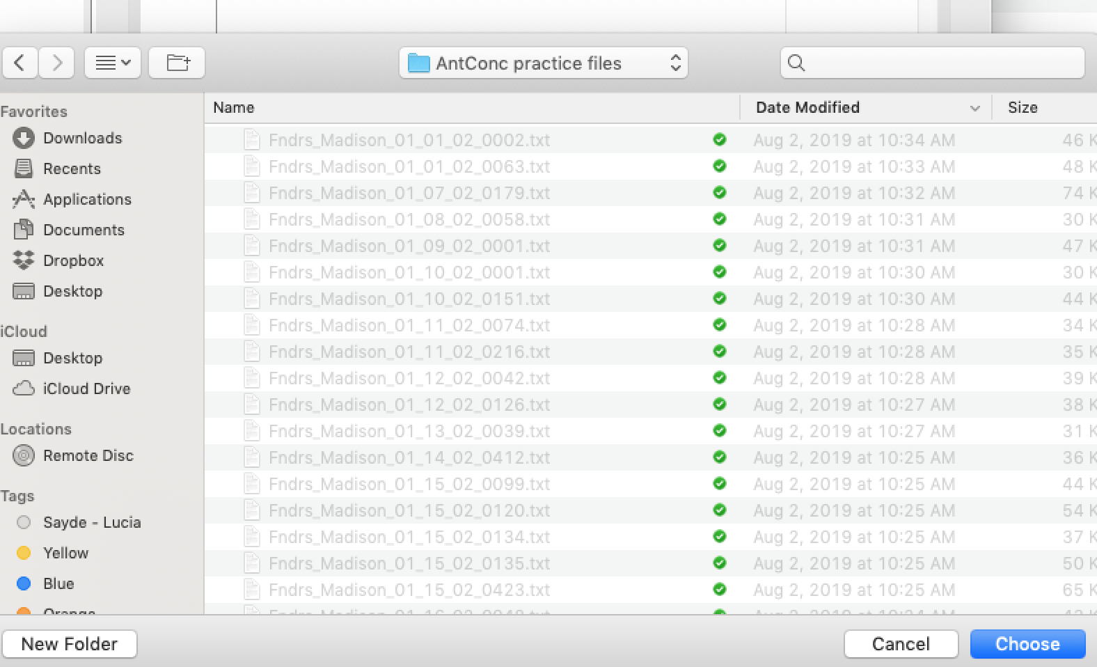

Slide 10
Word List
Cluster/N-gram
Patterns

Slide 12
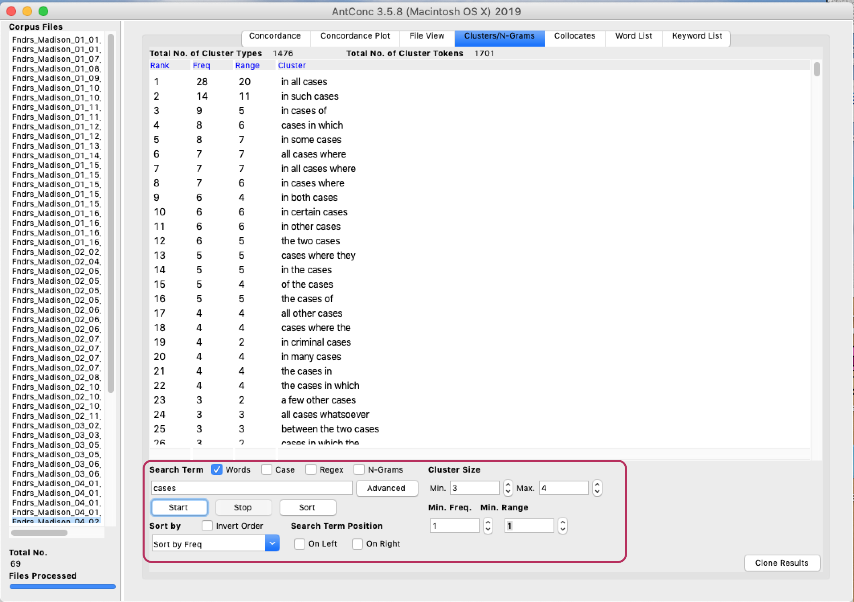

Slide 13
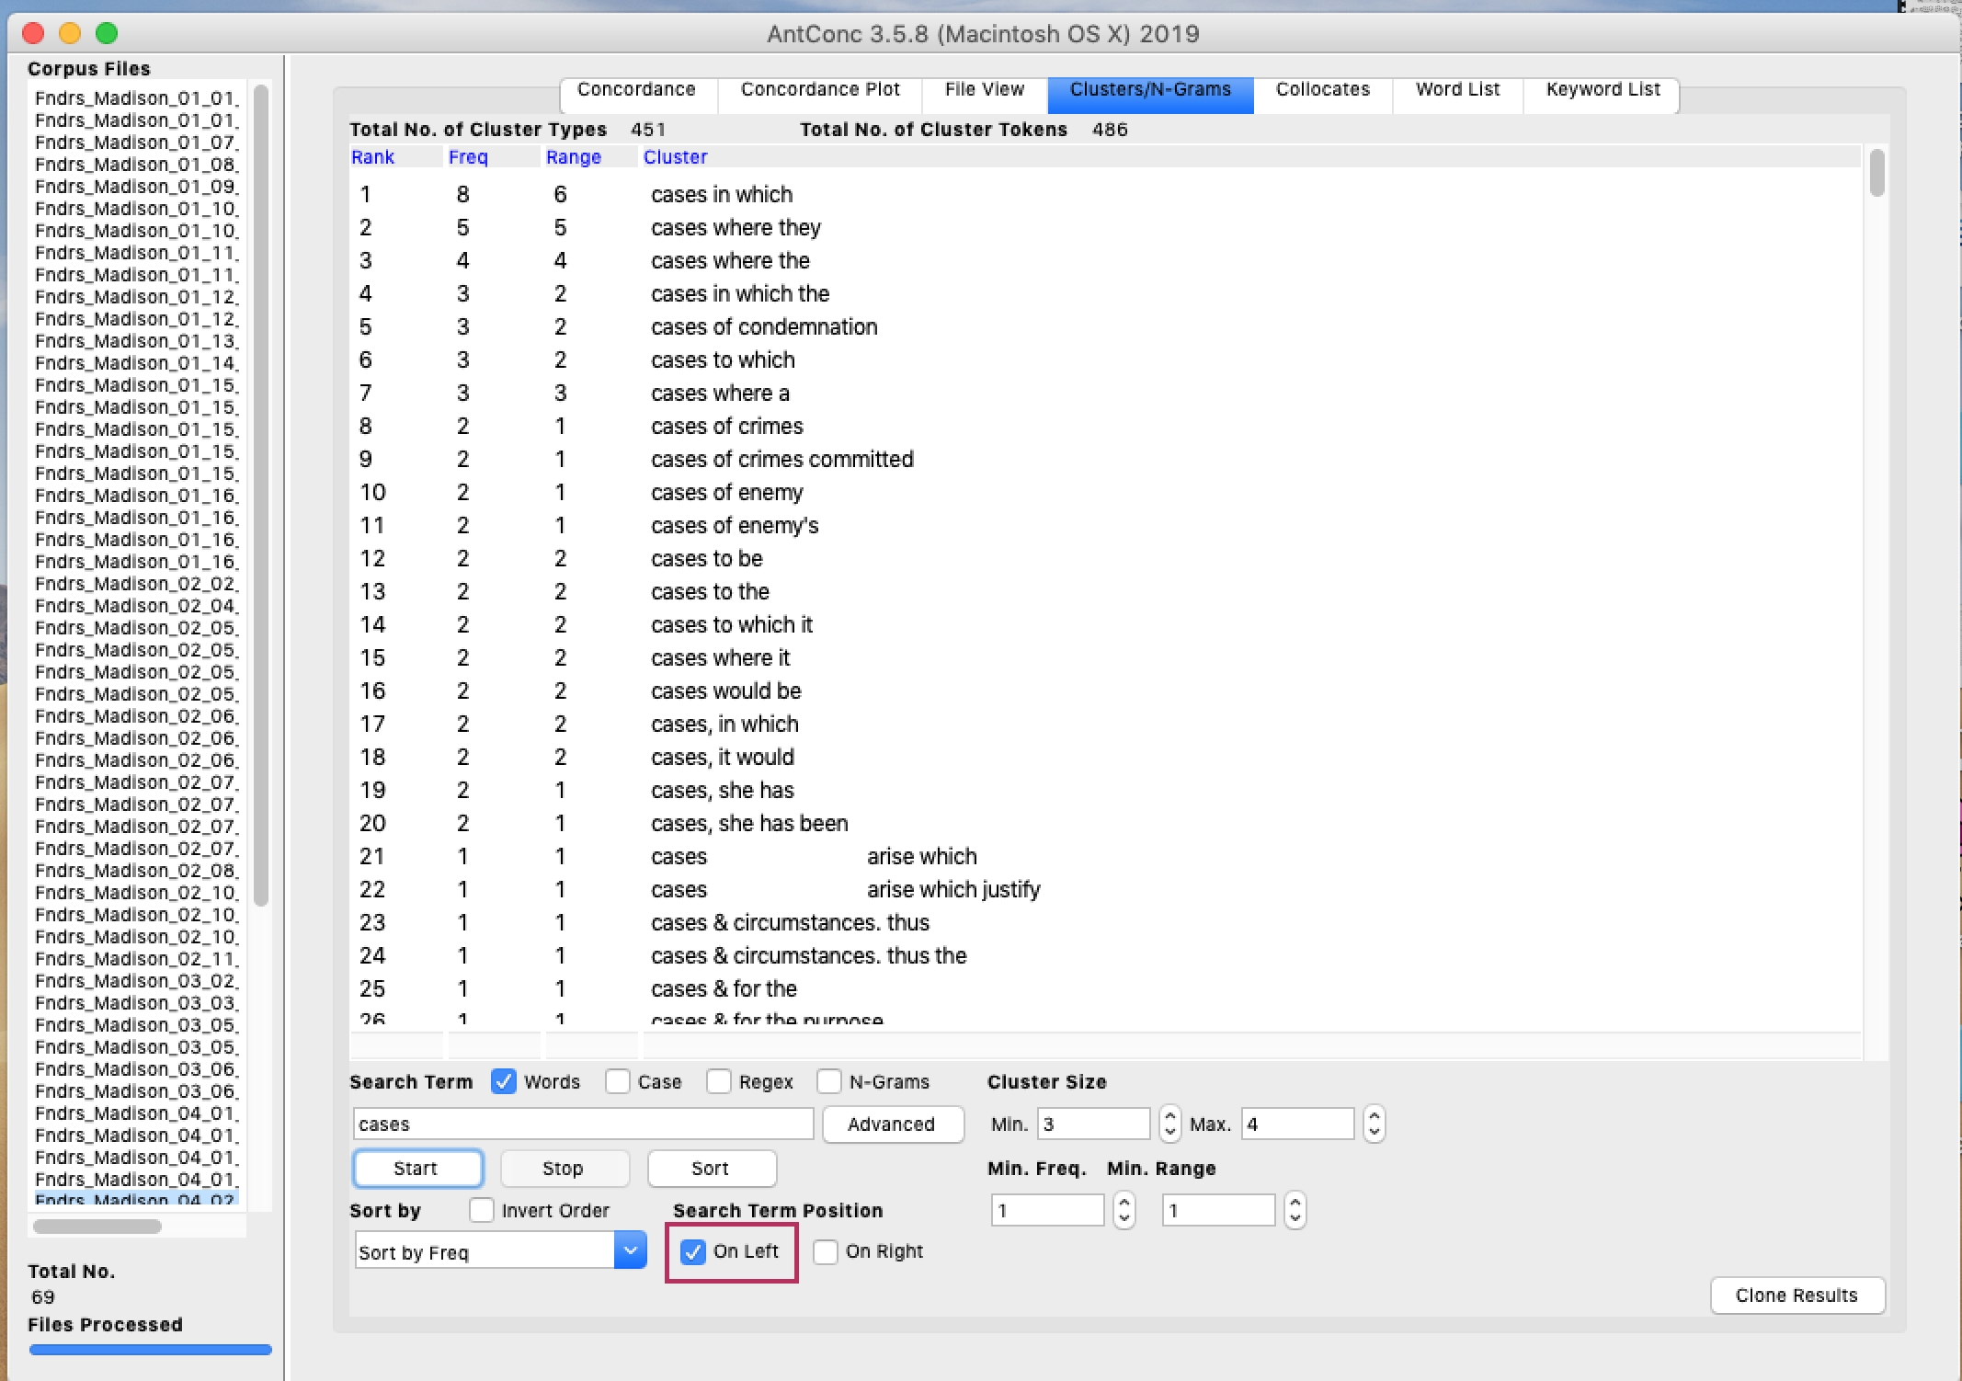

Slide 14
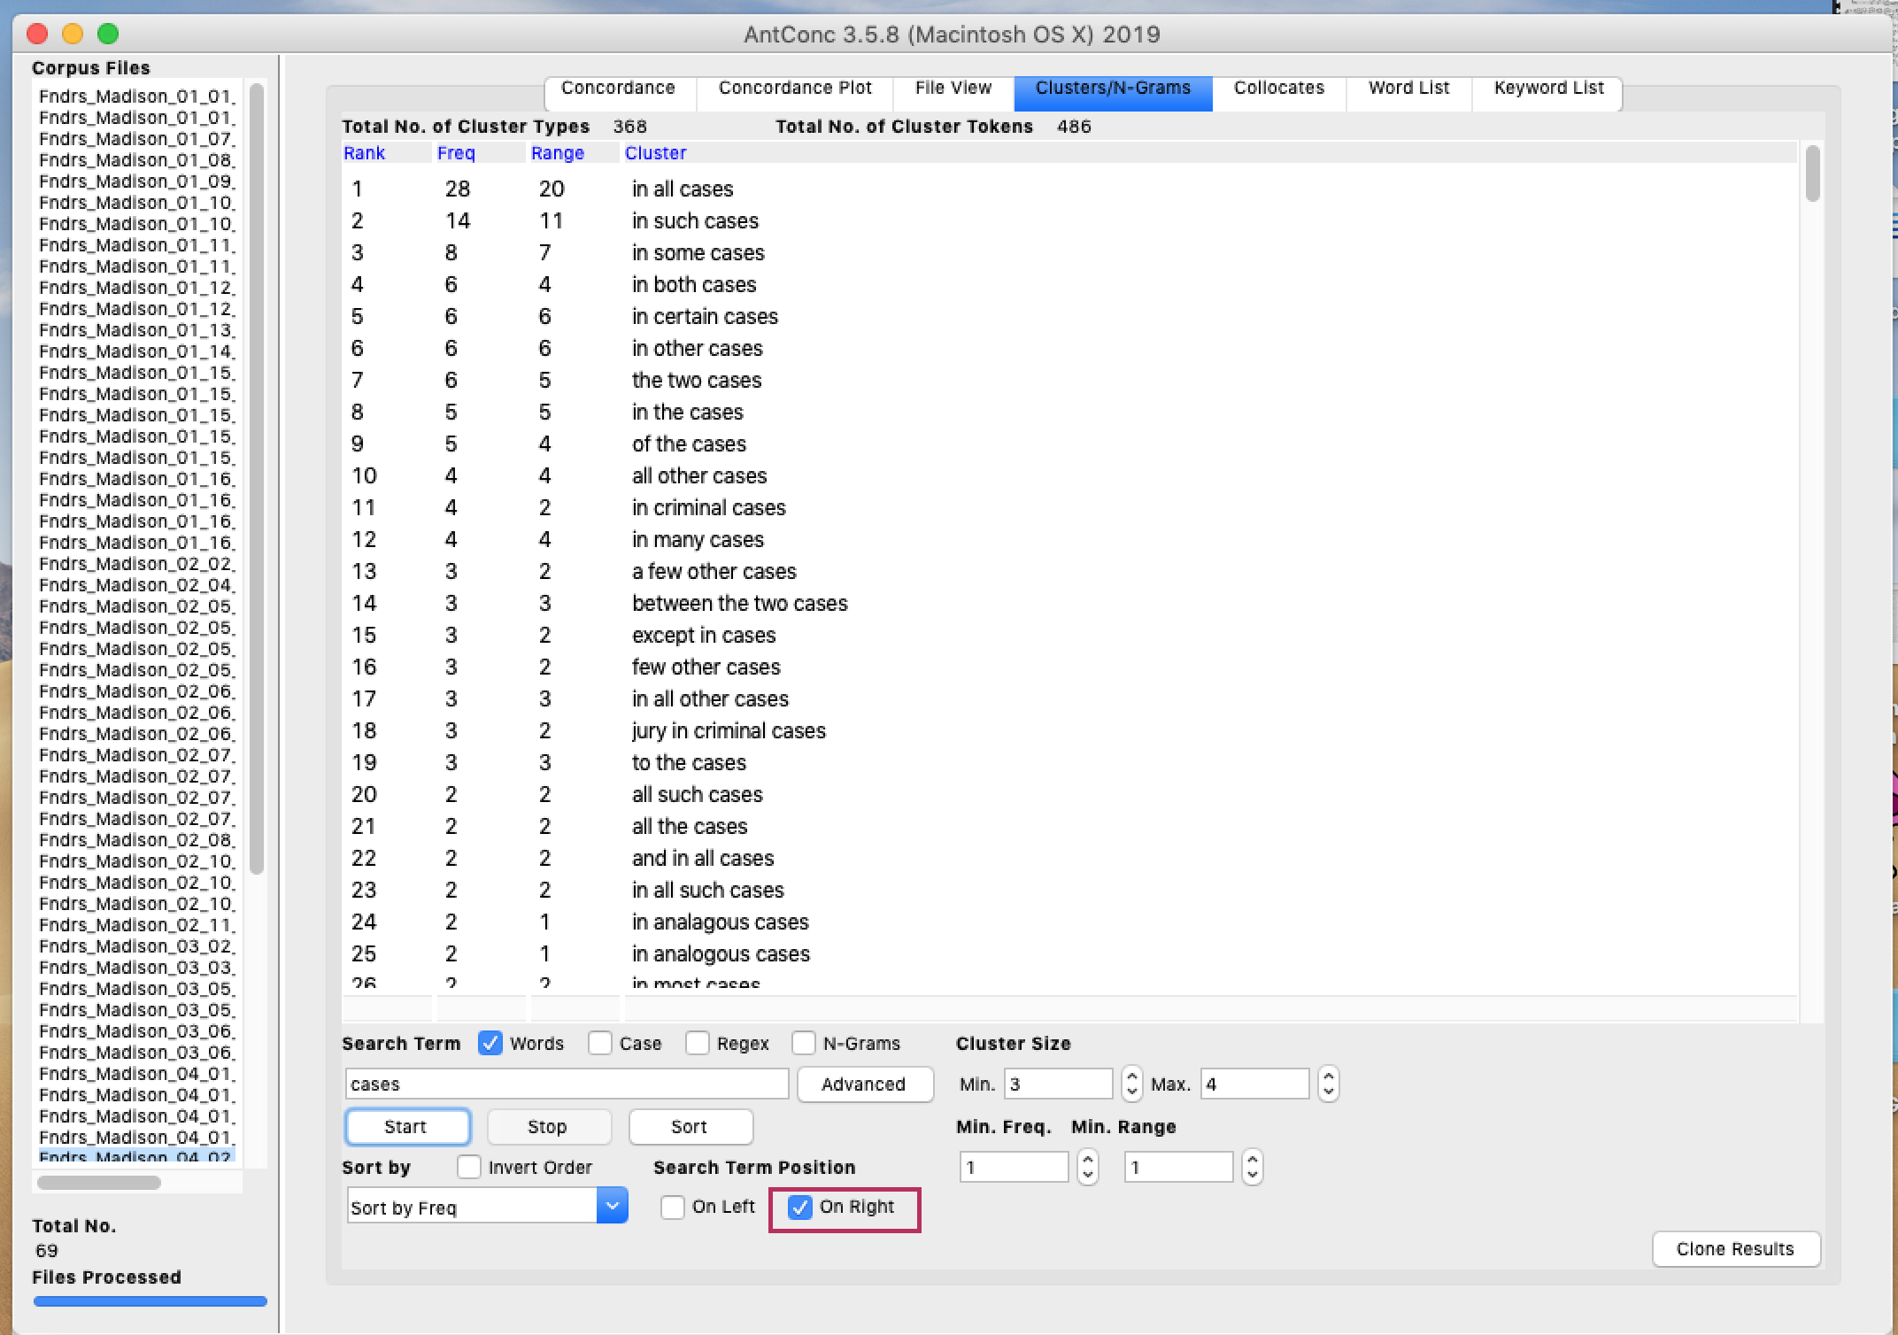

Slide 15
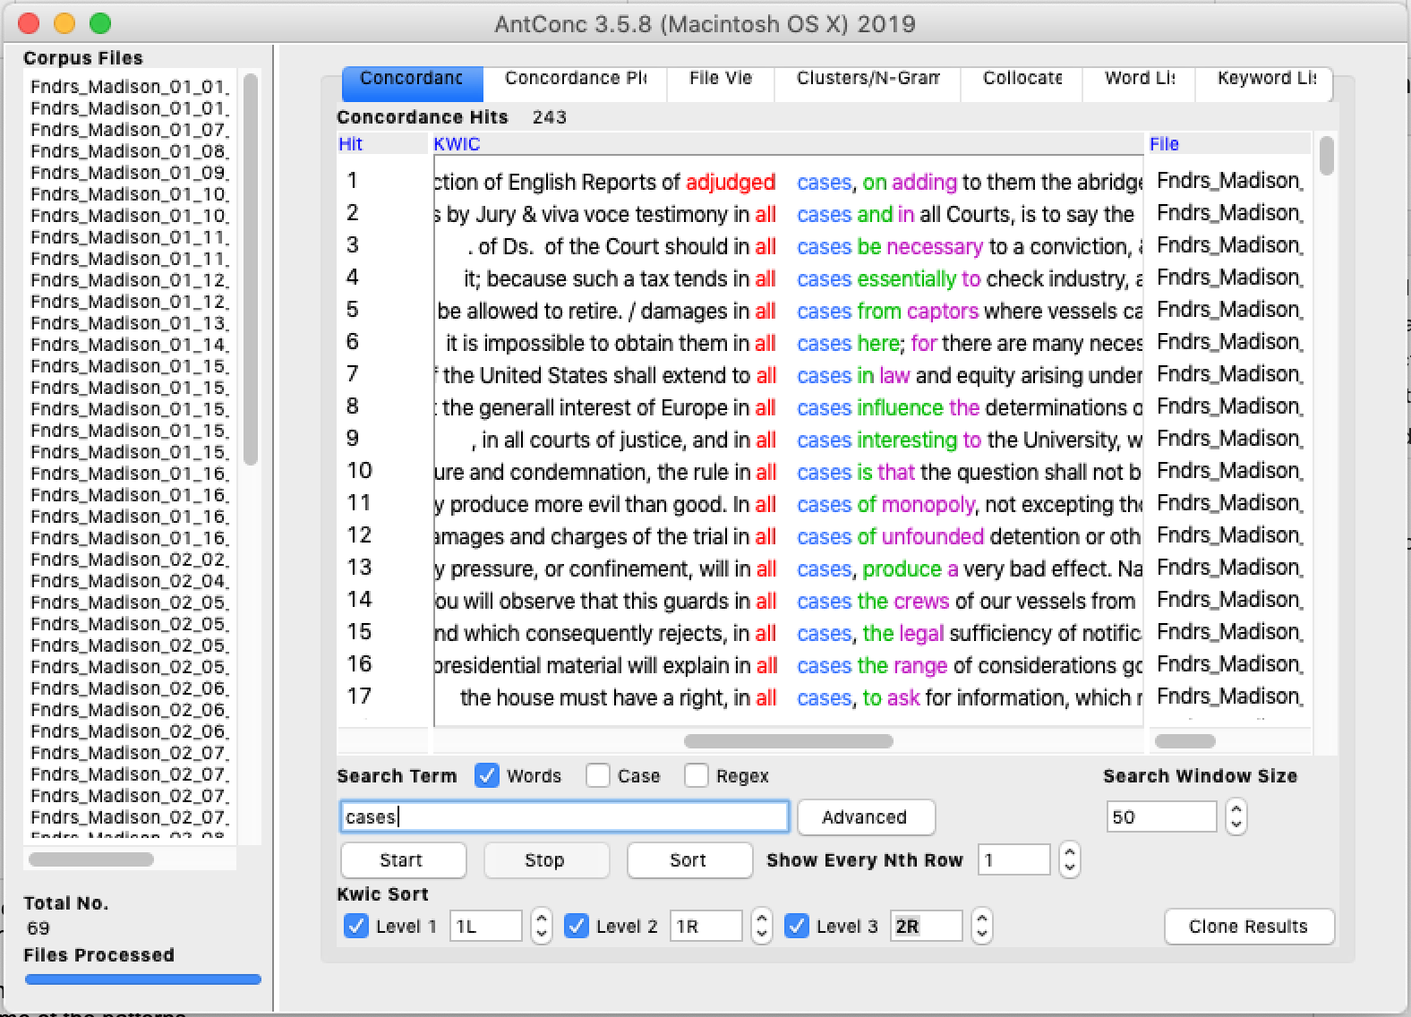
Notes:
Go back to concordance line and explain how it is sorted and highlight that it is color-coded. You can do in COFEA but it is easier to read in AntConc.
Looking at the words here and trying to see their meanings in context, I started to think about the concept of shell noun and how it fits some of the patterns.
Vague meaning
Shell content around

Slide 16
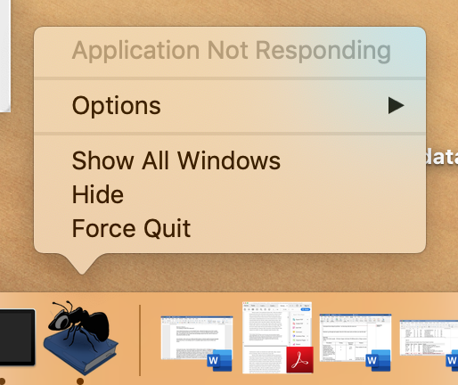

Slide 17
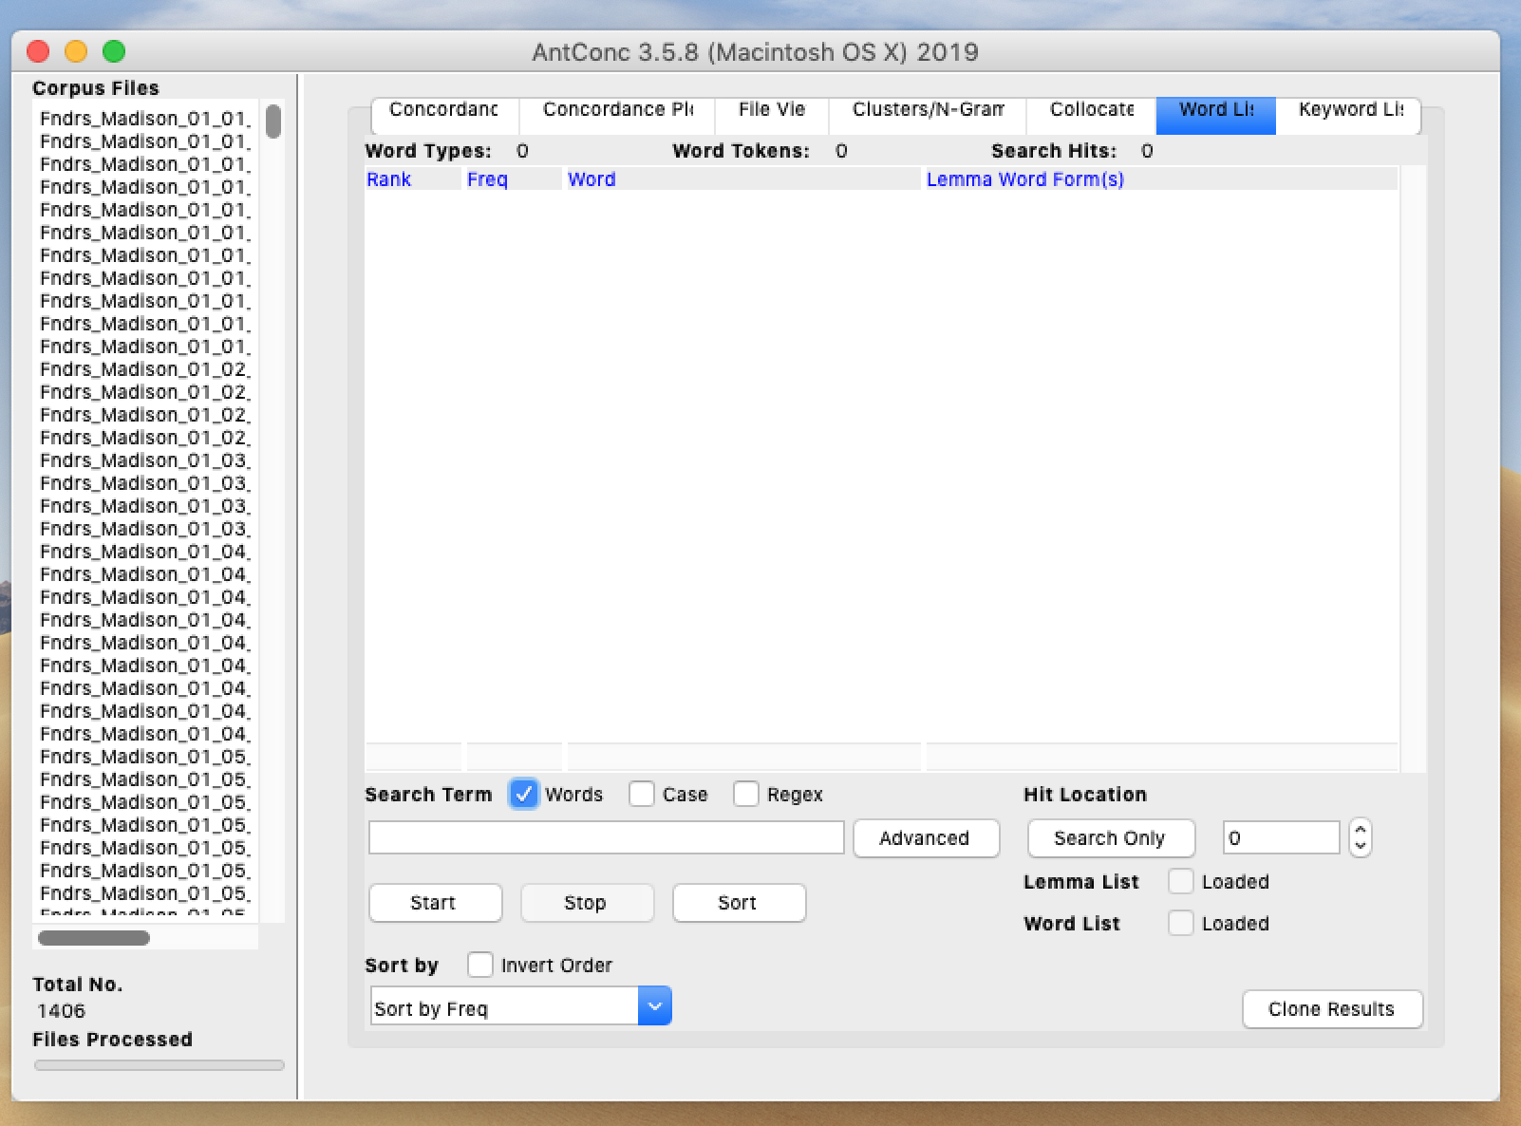
Word List
Word List
Frequency list of all words in all files

Slide 18
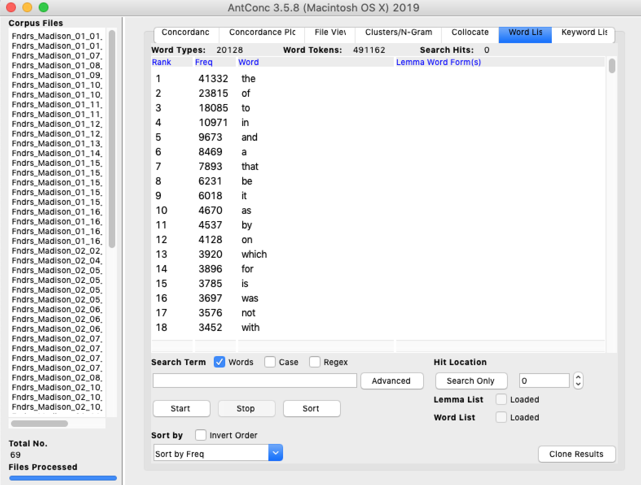

Slide 19
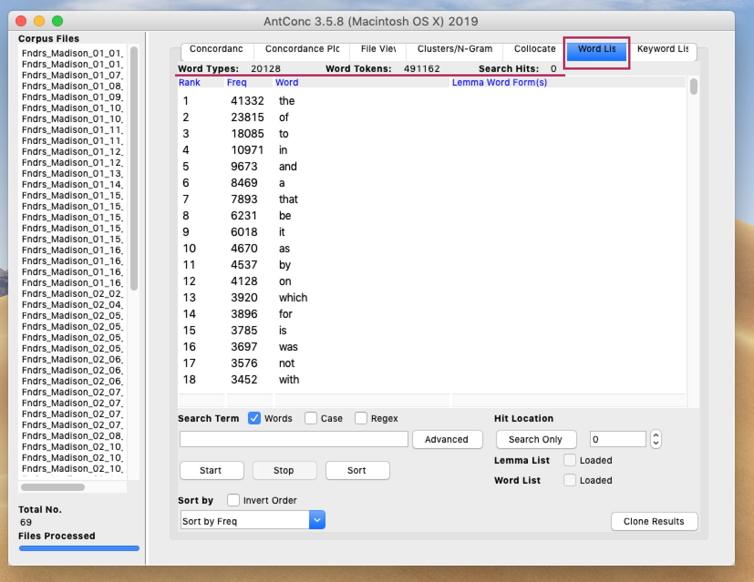

Slide 20
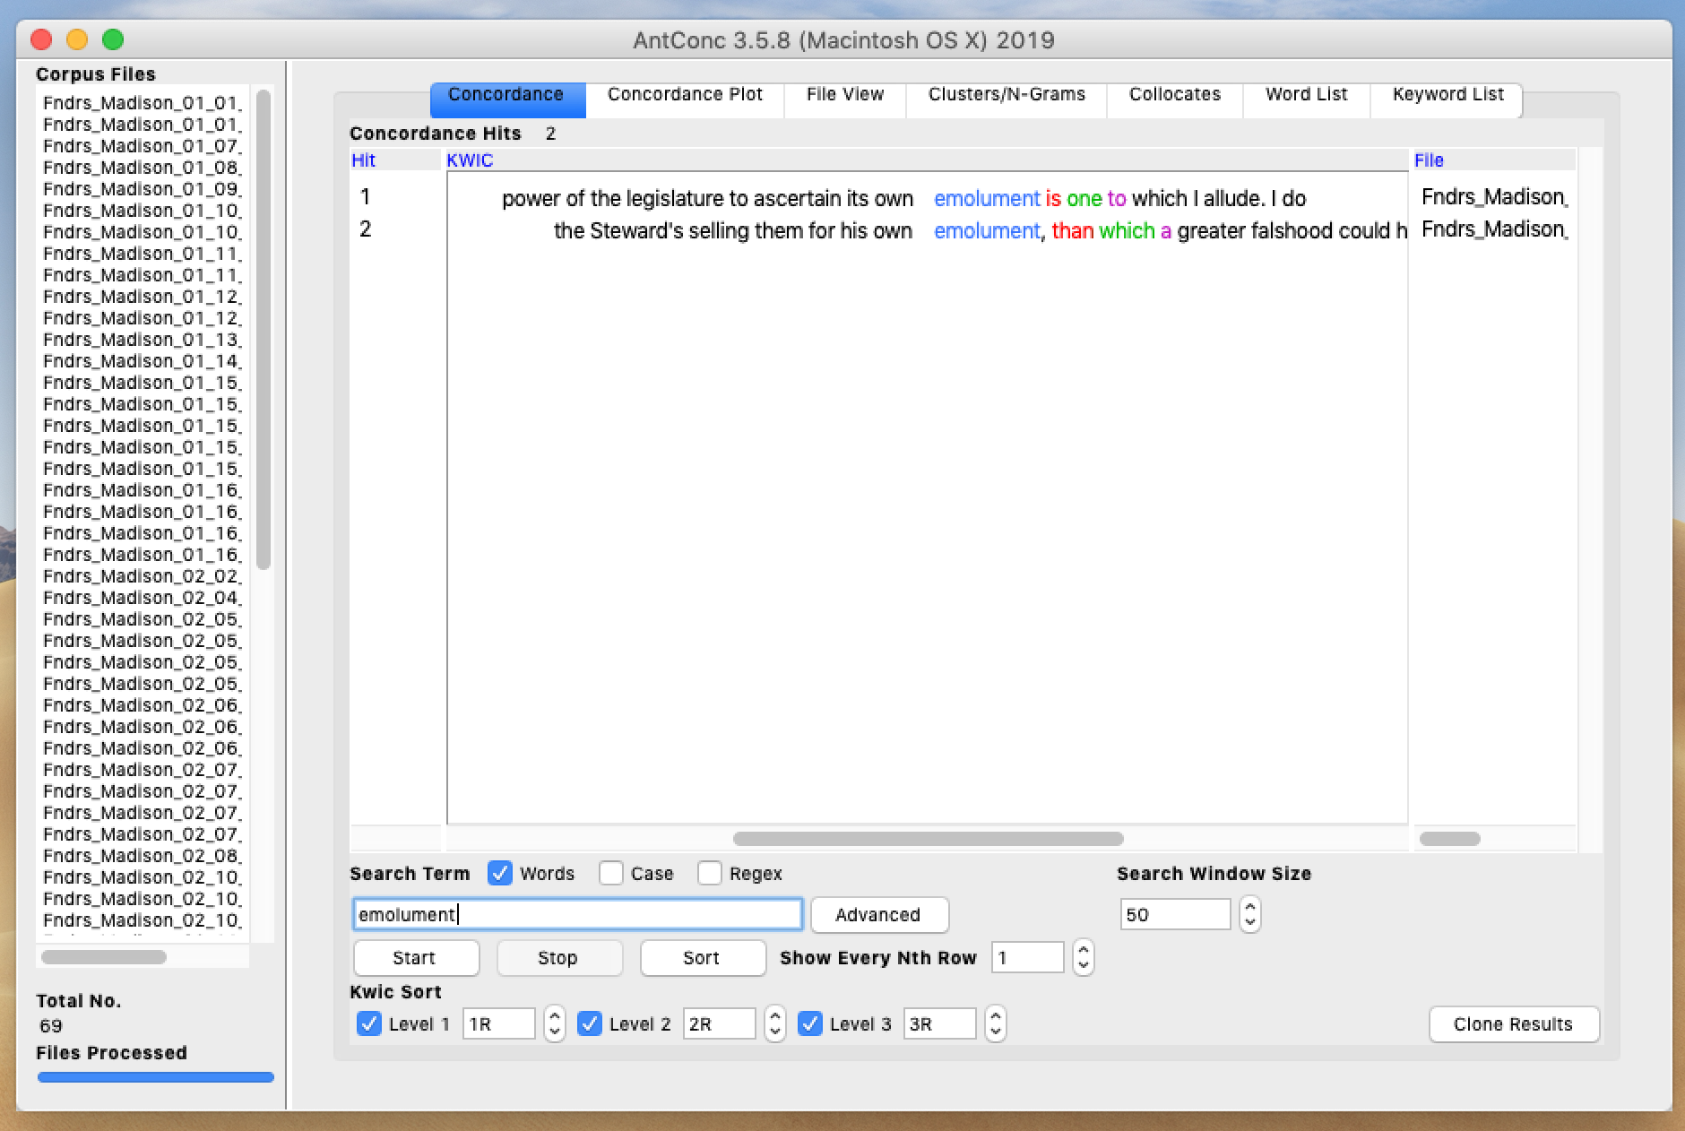

Slide 21
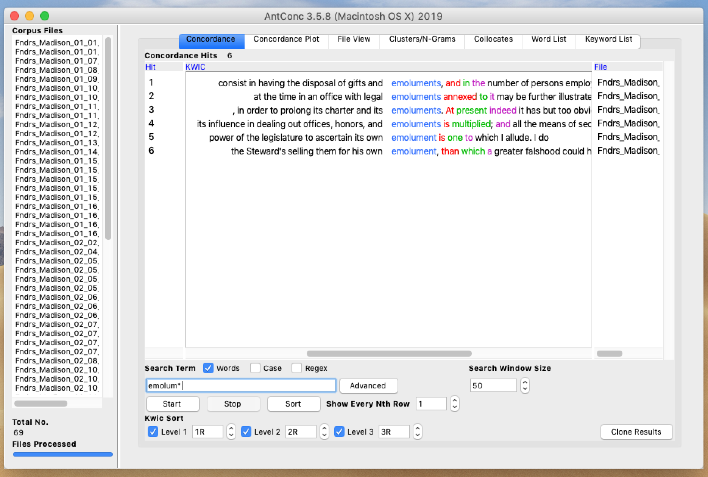

Slide 22
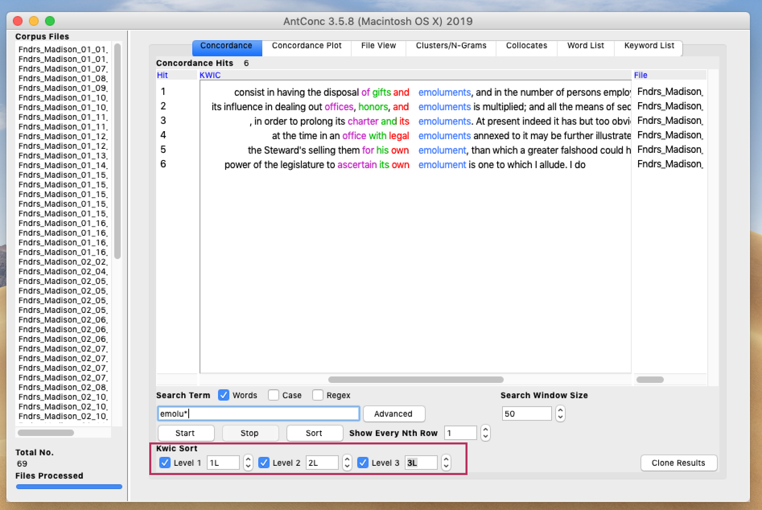

Slide 23
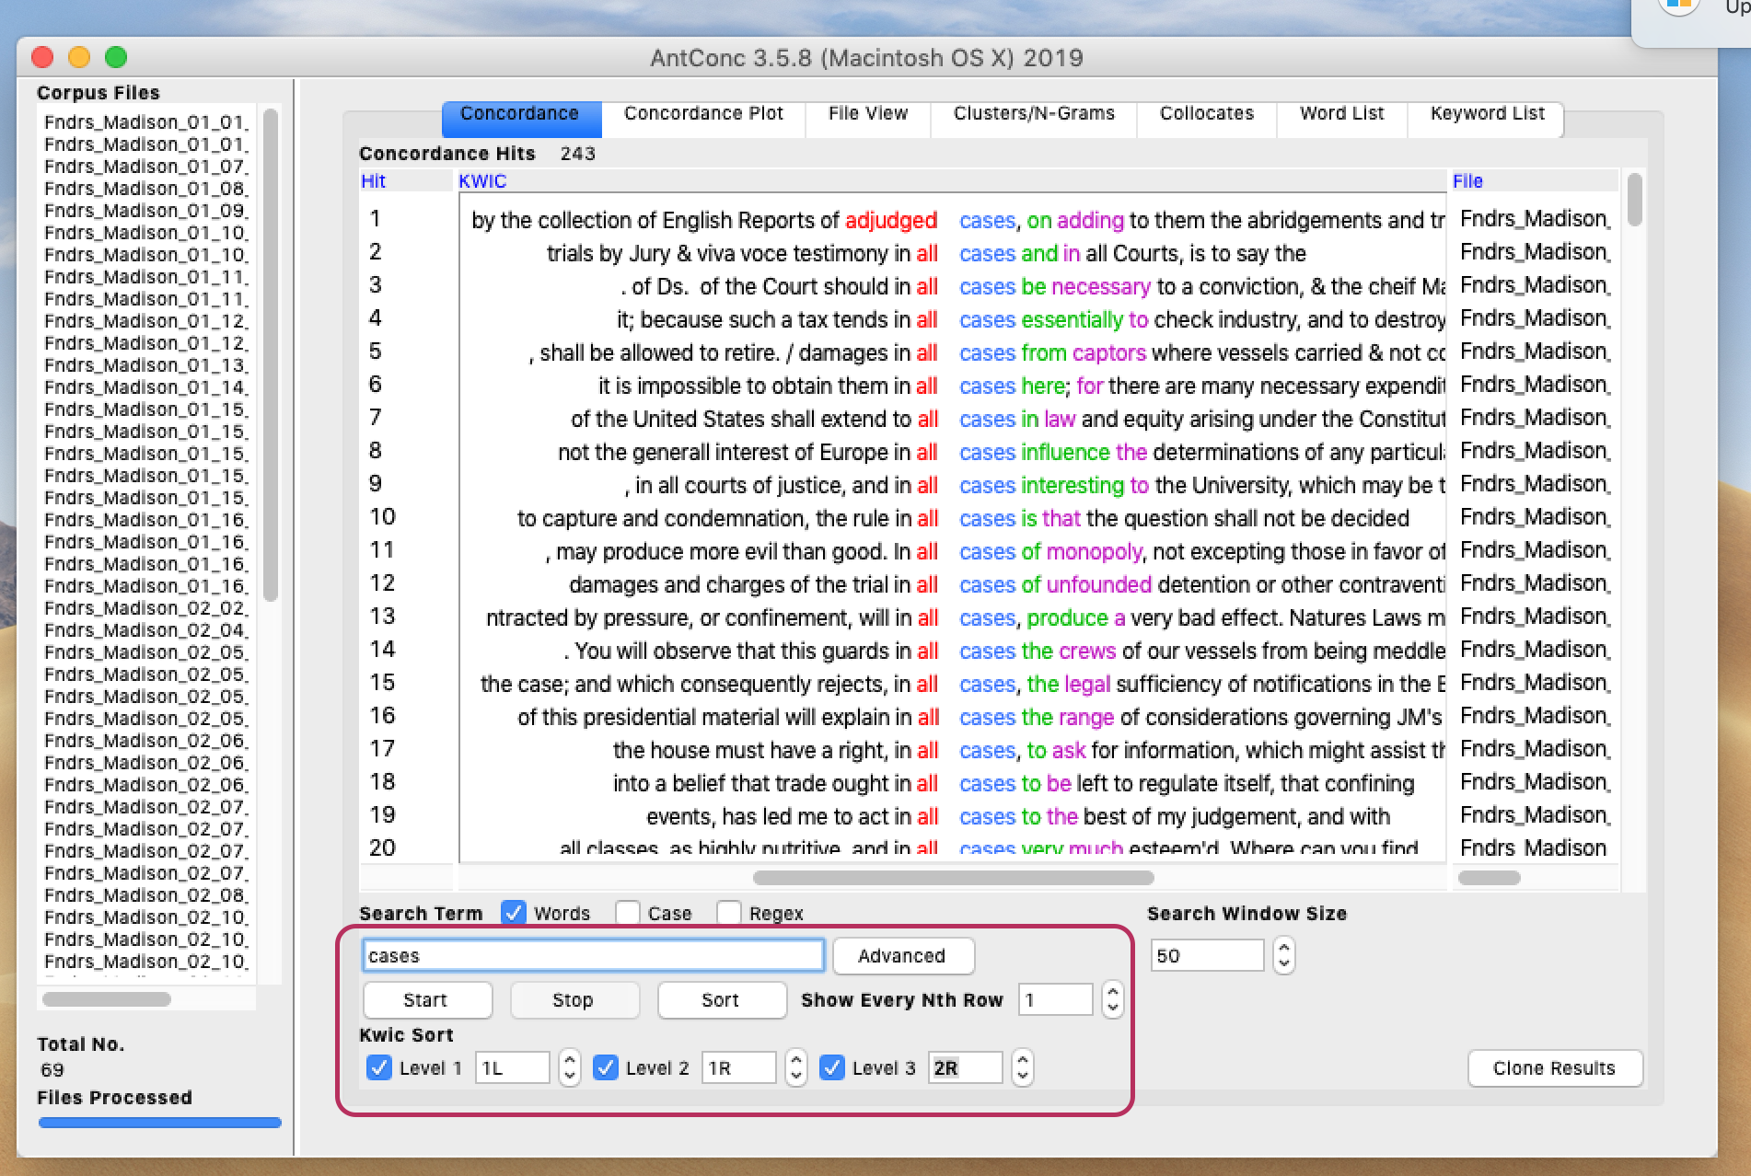

Slide 24
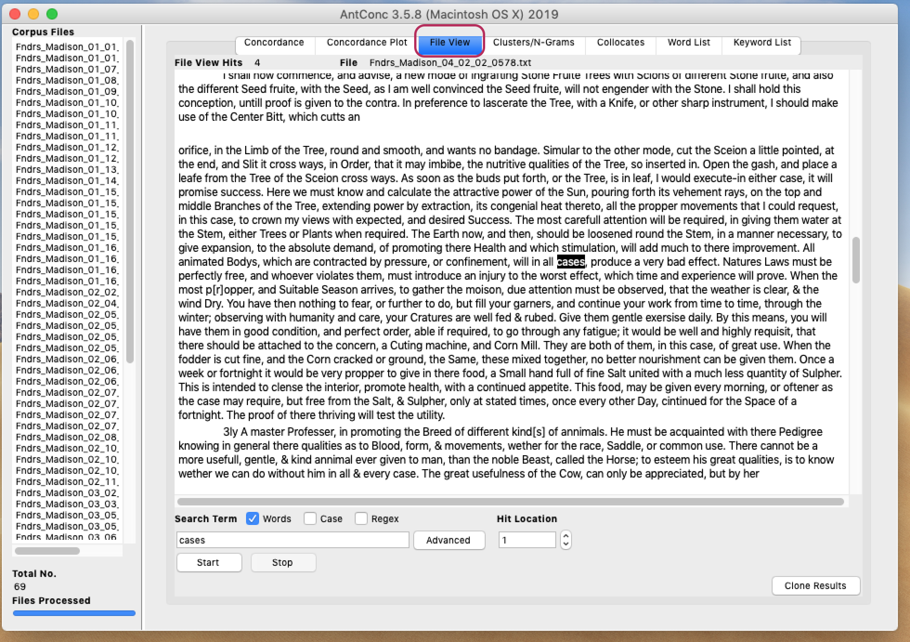

Slide 25
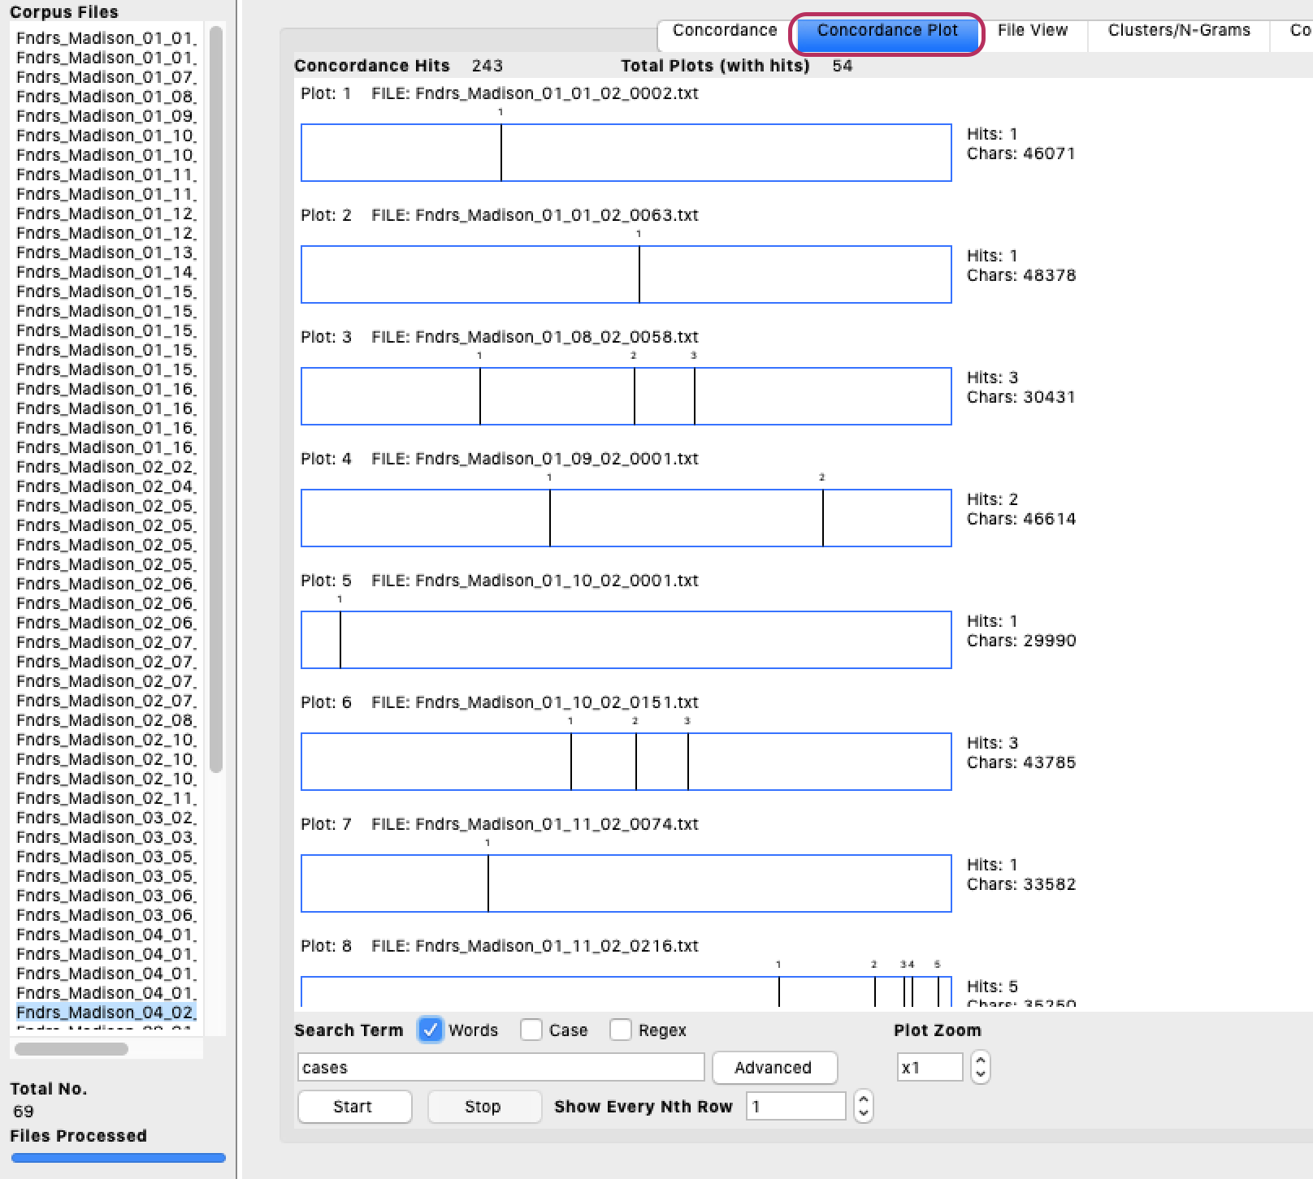

Slide 26
